Slide 1


Smart Healthcare Appointment System
Presented by :
Vijayalakshmi M
Thenmozhi E
Subalakshmi A
Kishore A
Yuvaraj R

Slide 2

Comprehensive Healthcare Appointment System
Patients frequently face long wait times and disjointed healthcare systems, resulting in significant inefficiencies. A comprehensive healthcare appointment system can address these issues by streamlining scheduling, enhancing communication between patients and providers, and improving access to health data, ultimately leading to better patient experiences and outcomes.

Slide 3

Current Healthcare Challenges
Long Wait Times
Appointment Mismanagement
Fragmented Data Access
Patients frequently experience extended wait periods for appointments, leading to frustration and potentially impacting their health outcomes.
Health data is scattered across various platforms, making it difficult for patients to access their information or communicate with healthcare providers seamlessly.
Existing systems often fail to effectively manage appointment scheduling, leading to overlaps, cancellations, and no-shows.

Slide 4




Healthcare Solution Overview
2
Improved Scheduling
The system will offer real-time availability, allowing patients to schedule, modify, or cancel appointments with ease.
Unified Platform
A comprehensive system will unify patient data, enabling easy access for both patients and providers.
1
Virtual Consultation Options
Incorporating telehealth features will facilitate consultations from home, reducing the need for in-person visits.
3

Slide 5
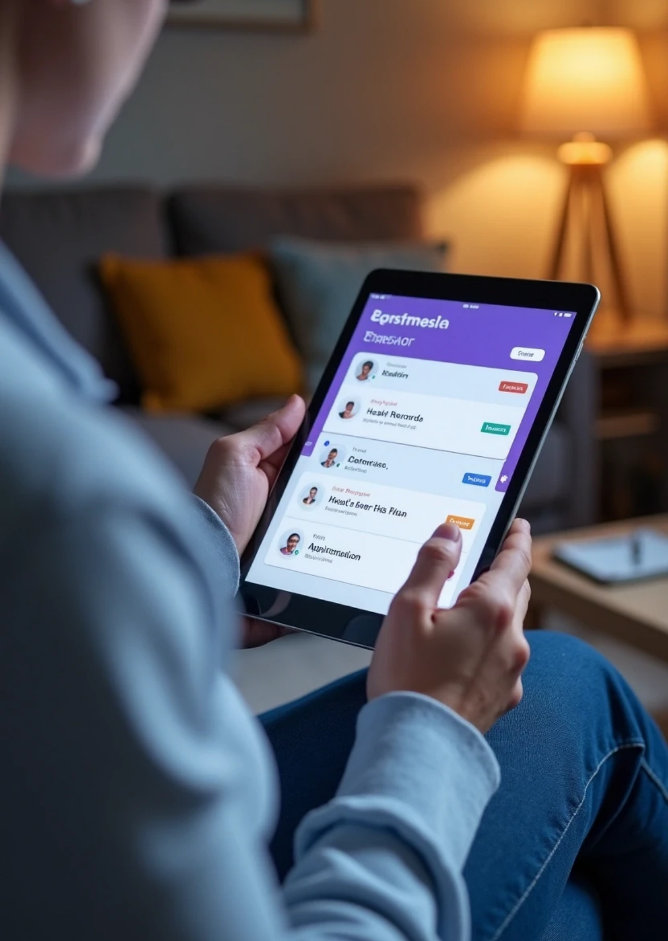


Benefits for Patients
Enhanced Convenience
Patients can schedule appointments from their devices at any time, eliminating the need to call clinics and wait for representatives.
Better Health Management
Access to a centralized health record enables patients to manage their health more effectively with direct insights and reminders.
Increased Engagement
Patients are encouraged to take a more active role in their health via easy communication channels with their healthcare providers.

Slide 6



Benefits for Healthcare Providers
Streamlined Workflow
Improved Patient Communication
Data-Driven Insights
Providers can manage their schedules more effectively, reducing administrative burdens related to appointment management.
With centralized data, providers can analyze patient trends and improve service offerings based on real-time feedback.
The system fosters better communication between providers and patients, enhancing the overall quality of care.

Slide 7



Key Features of the System
Real-Time Notifications
2
Patients receive reminders and updates on their appointments, reducing the likelihood of missed visits.
User-Friendly Interface
1
A simple, intuitive design that minimizes training requirements for both patients and healthcare staff.
Integration Capability
The system can integrate with existing healthcare software to ensure seamless adoption and data accuracy.
3

Slide 8


Technical Implementation
Cloud-Based Solutions
Utilizing cloud technology provides secure, scalable data access while accommodating a growing number of users.
Mobile Applications
Mobile versions of the system enable access on the go, catering to patients with varied lifestyles.
Data Security Measures
Strong encryption and compliance with health regulations (like HIPAA) ensure that patient data is protected at all times.

Slide 9



Case Studies of System Implementation
Hospital A
Clinic B
Practice C
Reported a 30% decrease in missed appointments and a significant increase in patient satisfaction scores.
Shared success in reduced administrative times due to automated scheduling and improved communication channels.
Experienced enhanced patient engagement with the introduction of virtual consultations, leading to an uptick in follow-up appointments.

Slide 10



Implementation Challenges
Interoperability Issues
Ensuring the new system works well with existing healthcare systems may present technical challenges that require careful planning.
User Adoption
Costs and Resources
Some patients may resist adopting new technologies; thus, educational efforts are crucial for engagement.
Initial costs for technology setup and ongoing maintenance resources may pose financial challenges for smaller practices.
2
1
3

Slide 11



Future Perspectives
Telehealth Expansion
As telehealth becomes increasingly popular, the system will continuously evolve to incorporate the latest technologies.
AI Integration
Incorporating artificial intelligence can enhance patient data analysis, automate scheduling, and streamline workflows further.
Personalized Patient Experience
Future iterations of the system can focus on personalization, tailoring communication and healthcare recommendations to individual needs.

Slide 12



Call to Action for Healthcare Organizations
Invest in Training
Training staff and patients ensures smooth transitions and maximizes system efficacy.
Collaborate for Change
Focus on Innovation
Encouraging healthcare organizations to embrace this system will significantly improve patient experiences and outcomes.
Continuous evaluation and improvement of the system based on user feedback will drive its success in the future.
2
1
3

Slide 13


Acknowledgments
Team Contributions
Research and Data Sources
Recognizing the efforts of all stakeholders involved in developing and implementing this new system.
Citing studies and statistics that support the need for a comprehensive healthcare appointment system and its benefits.

Slide 14


References in Healthcare Appointment Systems
Relevant Literature
Industry Standards
Articles, studies, and publications discussing challenges and innovations.
1
2
Guidelines and frameworks ensuring compliance with healthcare regulations.

Slide 15



Next Steps
Pilot Programs
Encourage the initiation of pilot programs to test the system in various healthcare settings and gather real-world feedback.
Expand Outreach
Develop marketing and outreach strategies to educate potential users about the benefits and functionalities of the new system.
Feedback Mechanisms
Establish channels for ongoing feedback from patients and providers to ensure continuous improvement and adaptation to changing needs.

Slide 16




Enhancing Patient Experiences
Implementing a comprehensive healthcare appointment system is vital for improving both patient experiences and operational efficiencies in healthcare settings. The key to success lies in effective collaboration among stakeholders, engaging users in the process, and maintaining a commitment to innovation.
1
2
Improved Experiences
Operational Efficiencies
A comprehensive healthcare appointment system significantly improves patient experiences.
It enhances operational efficiencies within healthcare facilities.
3
4
Successful Implementation
Commitment to Innovation
Successful implementation relies on collaboration and user engagement.
A strong commitment to innovation drives system effectiveness.

Slide 17



Conclusion of Healthcare Appointment System
A comprehensive healthcare appointment system addresses critical issues faced by patients and providers. By streamlining communication, scheduling, and access to health data, it will enhance overall healthcare quality and efficiency, paving the way for a more integrated and patient-centered approach.
Healthcare Appointment System
Enhanced Communication
Improved Scheduling
Access to Health Data
Patient-Centered Care

Slide 18






Q&A Session
1
Open Floor
Participants are encouraged to ask questions about the system’s functions, implementation strategies, and benefits.
2
Discussion Points
Facilitate discussions on potential integrations, user experience improvements, and addressing common concerns among patients and providers.

